Slide 1
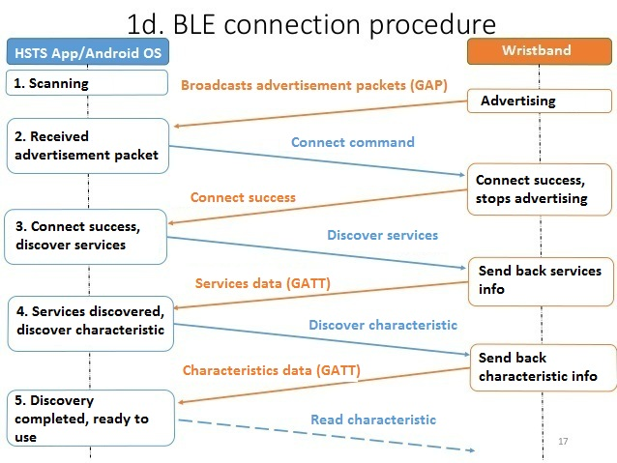
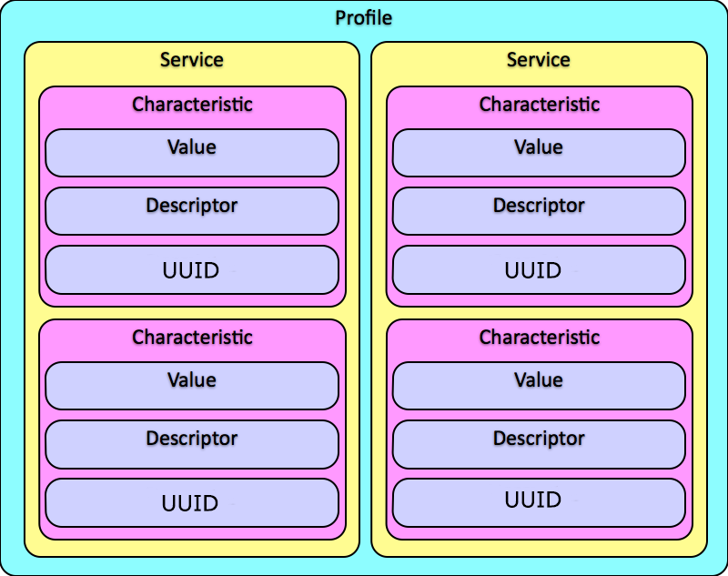

Slide 2

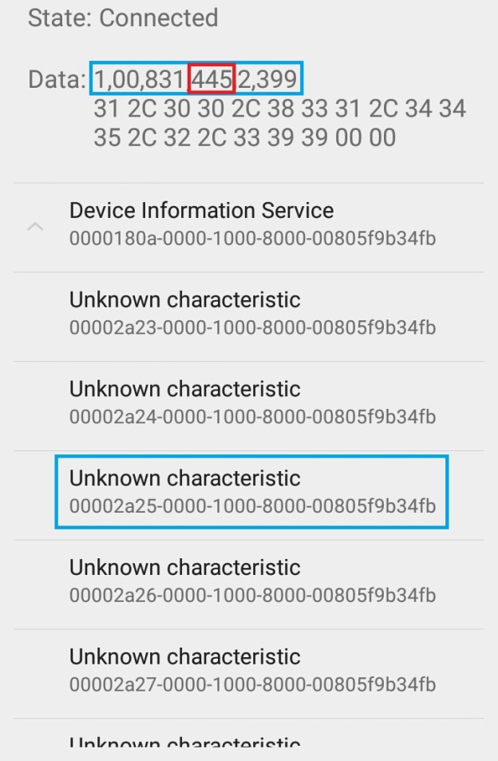
Device
ID
...
1
1..*
ParamMeasurement
ID
PositionHaveValue
UUID

Slide 3

ParamMeasurement
NumberOfStep: 445
Calories: ?
Distance: ?
Type 0 / 1
UUID
PositionHaveValue
PositionOfFormula
1
0..*
PropertyRecord
Value
1..*
1
MedicalRecordData
Type 2
...

Slide 4
PropertyRecord
Distance: z * x * 0.414 / 100000
Calories: y / 0.4536 * 0.53 * 1.609 * z * x * 0.414 / 100000
z,2,NumberOfStep
x,1,Height
y,1,Weight
Calories
Distance
NumberOfStep
1..*
1
PreventionCheck
MedicalRecordData
Height
Weight
Type 3
...

